Slide 1
Chicago Crimes
TEAM- F
Susheel Reddy Gurrala WX91253
Asad Khan US73618
Lavanya Mamillapalli QW21097

Slide 2
Our motivation towards this project is, we want
to analyze on Chicago crimes to know the exact
number of crimes and types of crimes occurred in
Chicago during the period of 2001-2021.
Project Motivation
Here we can know the number of crimes occurred in a day or in a month or in a year, so that this is helpful to reduce the crime-rate in Chicago.
While doing this project there is a drastic change in growth of crimes in between the years 2015 and 2016, And most of the crimes are thefts.

Slide 3
DATA DESCRIPTION
ID - Unique identifier for the record.
Case Number - The Chicago Police Department RD Number
Date - Date when the incident occurred. this is sometimes a best estimate.
Block - The partially redacted address where the incident occurred.
IUCR - The Illinois Uniform Crime Reporting code.
Primary Type - The primary description of the IUCR code.
Description - The secondary description of the IUCR code, a subcategory of the primary description.
Location Description - Description of the location where the incident occurred.
Arrest - Indicates whether an arrest was made.
Domestic - Indicates whether the incident was domestic-related as defined by the Illinois Domestic Violence Act.

Slide 4
DATA DESCRIPTION
11. Beat - Indicates the beat where the incident occurred.
12. District - Indicates the police district where the incident occurred.
13. Ward - The ward (City Council district) where the incident occurred.
14. Community Area - Indicates the community area where the incident occurred.
15. FBI Code - Indicates the crime classification as outlined in the FBI's National Incident-Based Reporting System (NIBRS).
16. X Coordinate - The x coordinate of the location where the incident occurred
17. Y Coordinate - The y coordinate of the location where the incident occurred
18. Year - Year the incident occurred.
19. Updated On - Date and time the record was last updated.
20. Latitude - The latitude of the location where the incident occurred
21. Longitude - The longitude of the location where the incident occurred.
22. The location where the incident occurred in a format that allows for creation of maps and other geographic operations on this data portal.

Slide 5
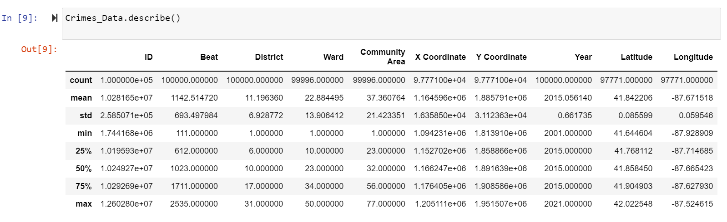
Descriptive statistics of a Dataframe

Slide 6

Exploratory Data Analysis(EDA)

Slide 7
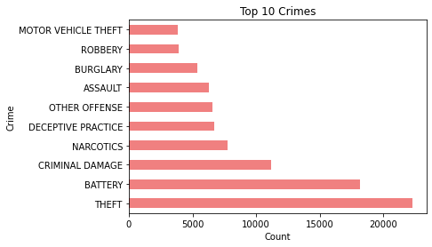
This is the visualization for top 10 crimes in Chicago.
If we observe here the highest crime occurred in Chicago is “Theft”.
TOP 10 CRIMES

Slide 8
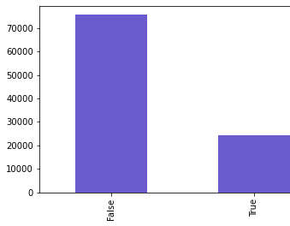
Arrest Rate
The visualizations shows the arrest rate.
True represents the people arrested in Chicago. There are very less people who are arrested.

Slide 9
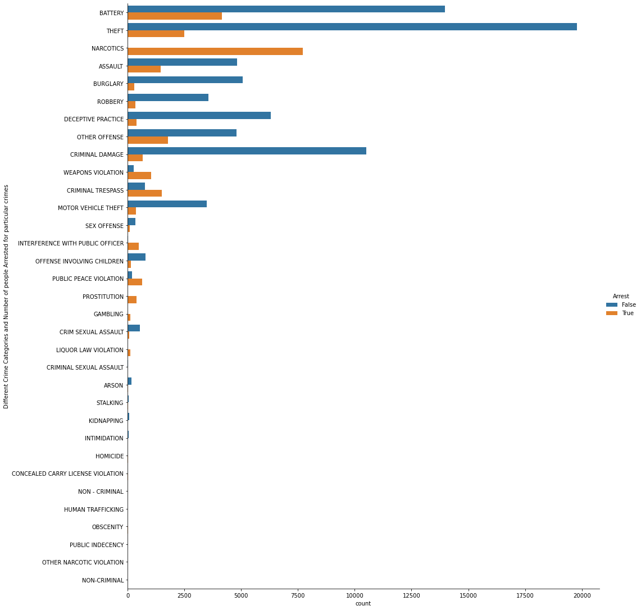
Arrest depending on Crime
The visualization shows the number of people arrested depending upon the crime.
Here if we observe, most of the people got arrested who are involved in crime “NARCOTICS”.

Slide 10
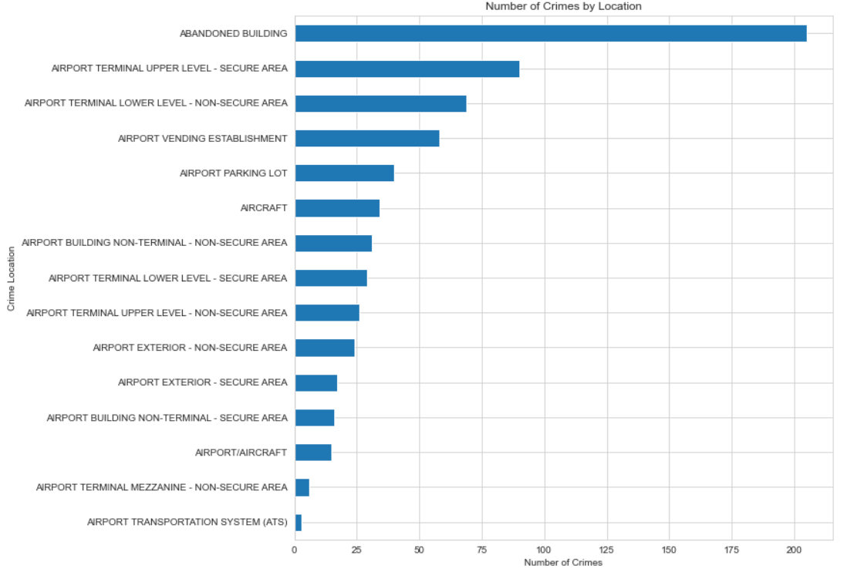
Crimes By Location
Here in this visualization, we can observe the crimes occurred by location and the large number of crimes occurred in Abandoned Building.
And the least number of crimes occurred in Airport Transportation System

Slide 11
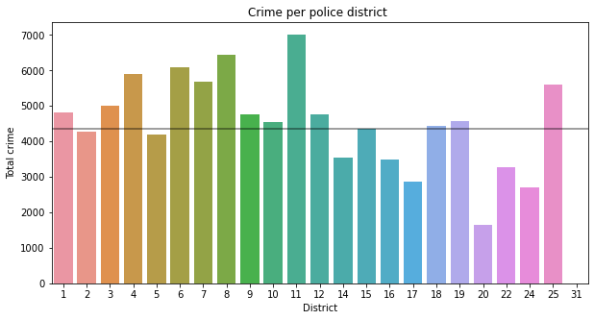
Crimes per police district
Here the visualization shows crimes per police district .Most of the crimes happened in the “11”​ district.​
And the least crimes occurred in 20 police district.​

Slide 12
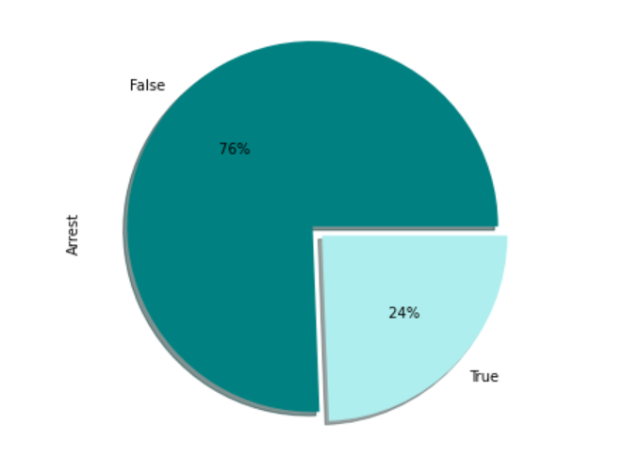
Number of criminals arrested

Slide 13
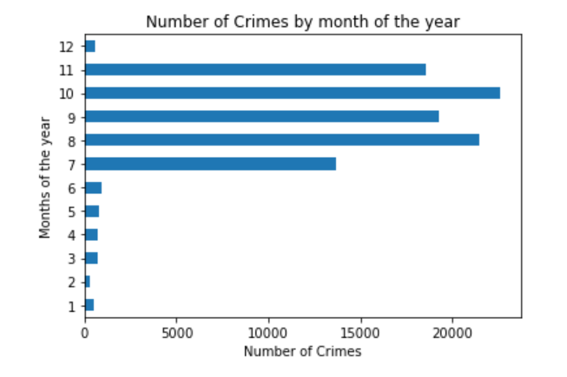
Number of Crimes by month of the year

Slide 14
MODEL:
Logistic Regression Classifier:​
Logistic Regression is the most basic model that usually
works on any data frame and the scores given by the logistic
regression are accurate depending upon my data set.​

Slide 15
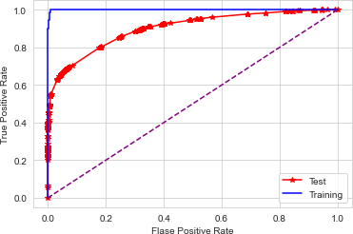
ROC Curve
The columns used for Roc Curve are Case Number , IUCR, Primary Type, Arrest, Domestic, FBI .

Slide 16
MODEL RESULTS
ROC-Accuracy Score: 90.20%​
Logistic Regression score: 88.60%​
F-1 Score: 72.96%​

Slide 17


A typical approach is, to improve a model to use more data. In this case, I have only taken the chunk data i.e., 100000 but including whole can improve the overall score as taking the chunk lot of data got missed like number of years or months.
We could try various techniques, such as neural network, but this could lead to additional problems and is overkill.
For more exploration we can use ensemble models, by using this the scores may get improved.

Slide 18


THANK YOU

